Slide 1
Machine Learning-Based Condition Monitoring and Forecasting of Subsea Hydraulic Systems Using Time Series Data Ross Thomson MSc Project

Slide 2

Project Motivation and Objectives
Why ?
Automate the monitoring of an Oil and Gas Subsea Production Hydraulic Control System. Anomalies/Failures result in production downtime, Subsea intervention and Environmental non-compliance reports.
Objectives:
1.Implement a machine learning based models to identify hydraulic fluid losses and abnormal system behaviour (high/low pressures, loss of redundancy, low tank levels, high return flow rates). Condition Monitoring / Anomaly Detection utilising Neural Network Machine Learning.
2.Monitor pump runtimes from the data to determine maintenance requirements. Predicitve Maintenance.
3.Predict future fluid consumption for environmental reporting and commercial purposes to ensure optimal quantities of hydraulic fluid is ordered. Time Series Demand Forecasting.
4.Calculate and display other useful data for operator such as daily/weekly/monthly fluid usage, umbilical charge volumes, high periods of valve ops, fluid added to tank, valve ops and expected fluid consumption. This may be by way of a Power BI dashboard to provide a single page with clear concise information. Data Manipulation and Visualisation.
5.Generate automated compliance-ready reports for submission to the regulatory authorities. Data Reporting
6.Use algorithms developed on static data for Real Time Data Monitoring. Deliver Real Life Value

Slide 3
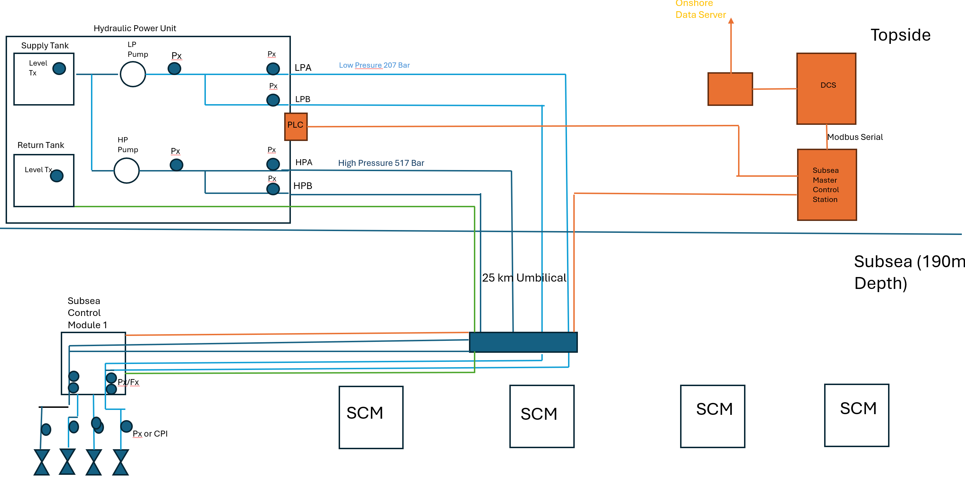
Subsea System Overview Example

Slide 4
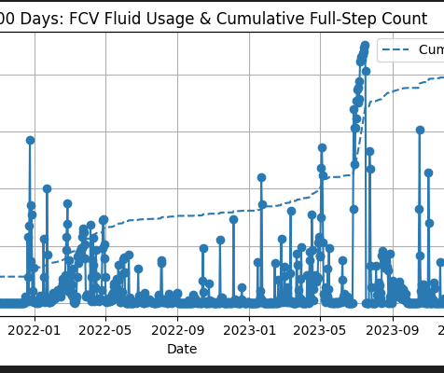
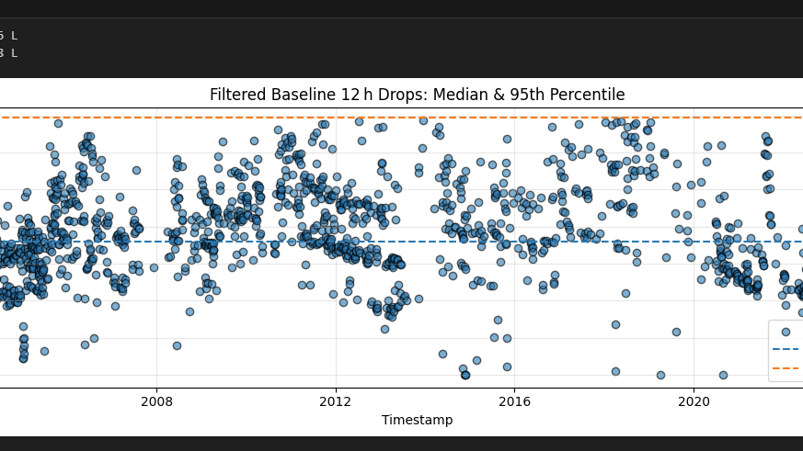
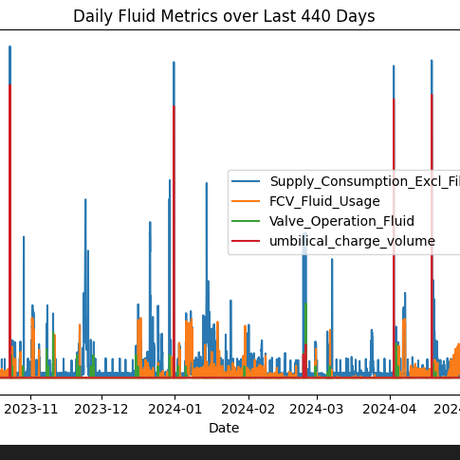
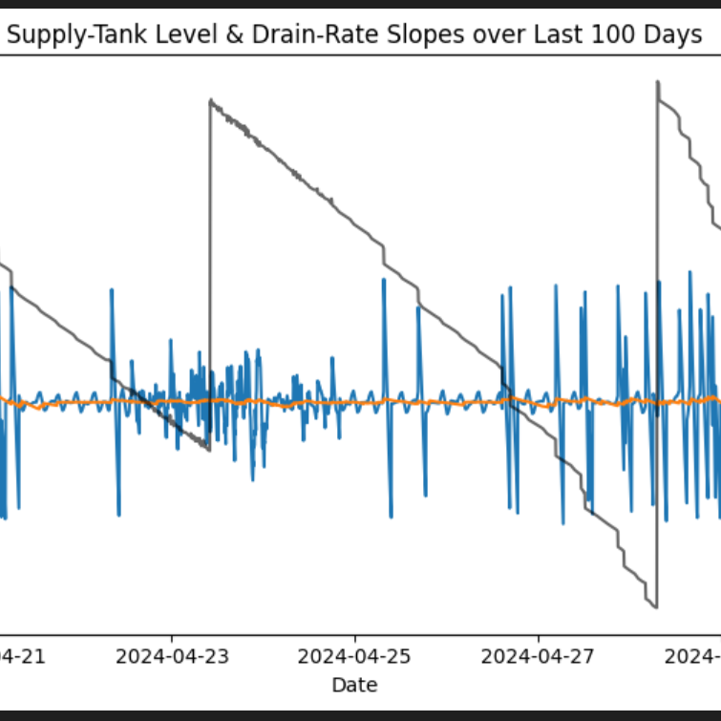
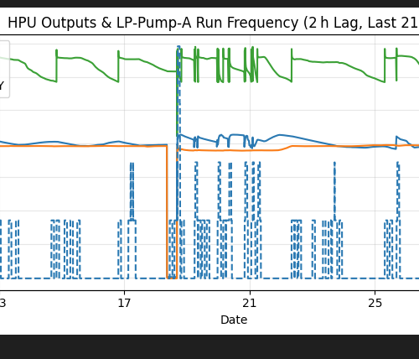
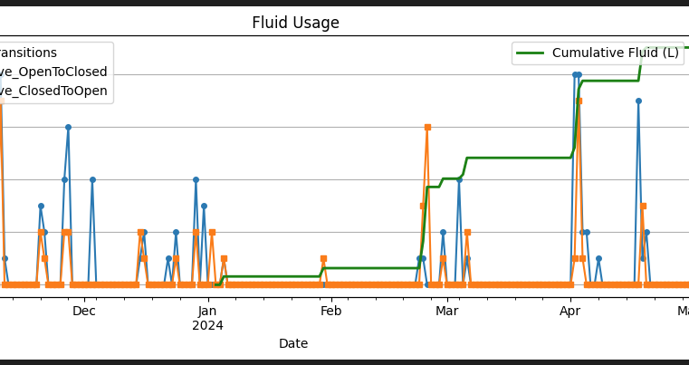
Time Series Data
TAQA have operated 8 UKCS subsea systems . Time series data available over 20 years of operation taken from Onshore Real Time Monitoring system in csv format.
Initial Data noisy. Various functional algorithms now completed to clean, manipulate and perform feature Engineering, Functions kept generic to be used across any system dataset.

Slide 5
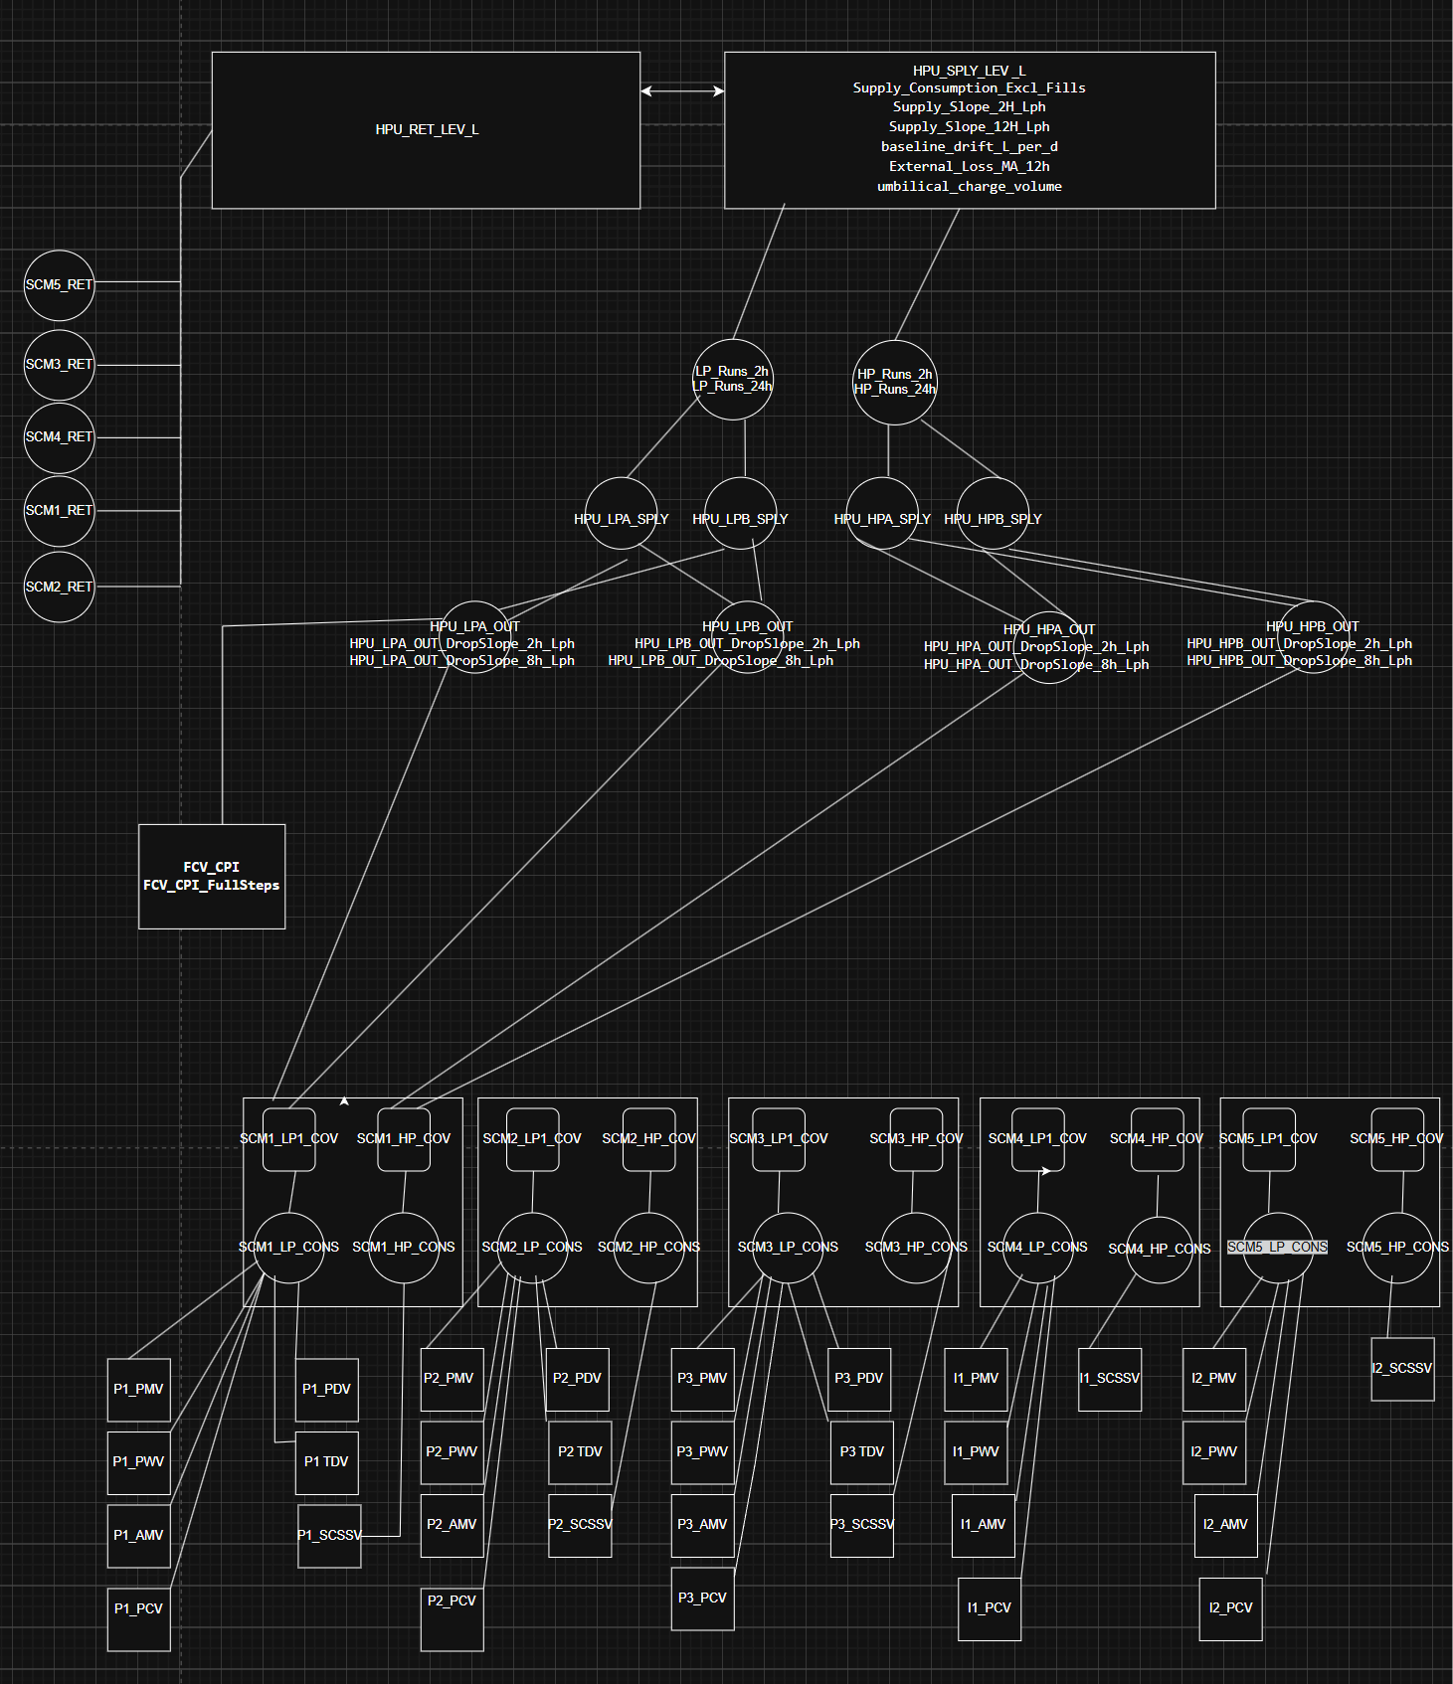
Anomaly Detection Methods and Forecasting
Condition Monitoring / Anomaly Detection Techniques
Simple Thresholds – Calculating the normal operational parameters of pump frequency, fluid use stable ops, Pressure delta then anomalies can be detected.
Topology Graph Neural Networks (GNN) Machine Learning. Hydraulic systems are interconnected networks, Anomalies will propagate through a system. A GNN is well suited to time series mechanical systems to learns how data points behave and how they relate — crucial for anomaly detection.
Forecasting
ARIMA (AutoRegressive Integrated Moving Average):
Suitable for stationary time series
Captures trend and seasonality
Provides a strong statistical baseline for fluid consumption forecasting.

Slide 6
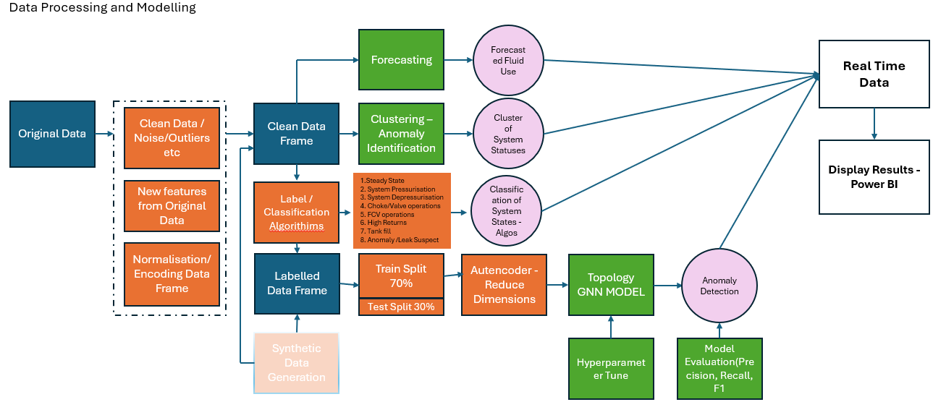

Slide 7
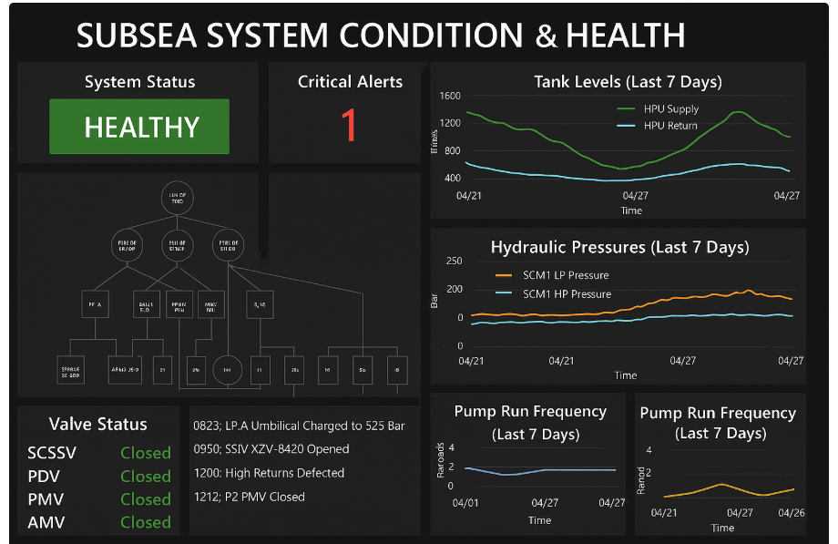
Present Status to Operators and Engineers

